Slide 1
V N S LAKSHMI AISHWARYA ERANKI
Username:LVADSUSR67
Excel Final Assessment

Slide 2
Question 1
No duplicate rows found

Slide 3
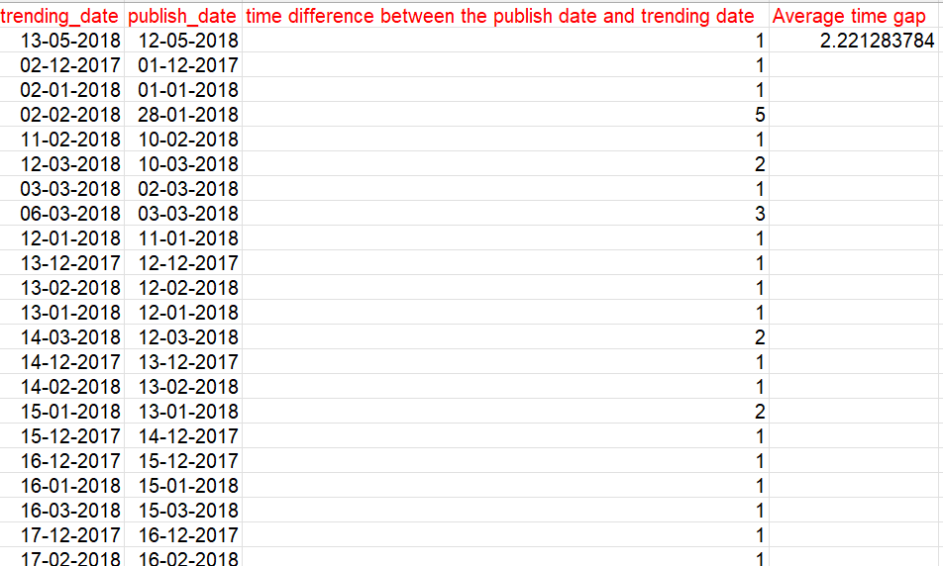
Question 2
Formula to calculate the difference between the publish date
and trending date
DAYS(A2,B2) Here, A2 represents trending date
B2 represents publish date
Formula to calculate the average time gap
AVERAGE(C:C) Here, C:C represents the
time difference between the
trending and publishing date
Answer : 2.2212

Slide 4
Question 3
Formula to assign category names
XLOOKUP(E2,Category!A:A,Category!B:B,"no",0)
Engagement rate
(SUM(H2,J2)/G2)
The category with highest average
Number of views and engagement
Rate is Autos and vehicles

Slide 5
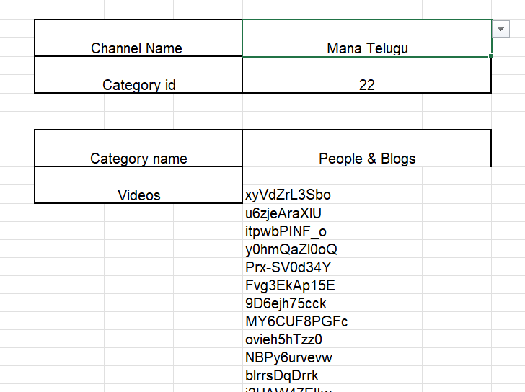
Question 4
Used data validation to get the channel titles
Formula to get the category id from channel title using xlookup
XLOOKUP(F3,'category name'!D:D,'category name'!E:E,"no",0)
Formula to get the category name from category id using xlookup
XLOOKUP(F5,Category!A:A,Category!B:B,"no",0)
Used filter to get the videos from a specific channel and category
FILTER('YouTube data'!A:A,'category name'!Q:Q=Sheet10!F9)

Slide 6
Question 5
Formula to concatenate the channel title and the video title column
CONCAT(C2,D2)
Text join formula
TEXTJOIN(",",TRUE,FILTER('category name'!P:P,'category name'!S:S='Question 5'!A1))

Slide 7
Question 6
No of videos with comments disables = 592
COUNTIF('category name'!K:K,'category name'!K2)

Slide 8
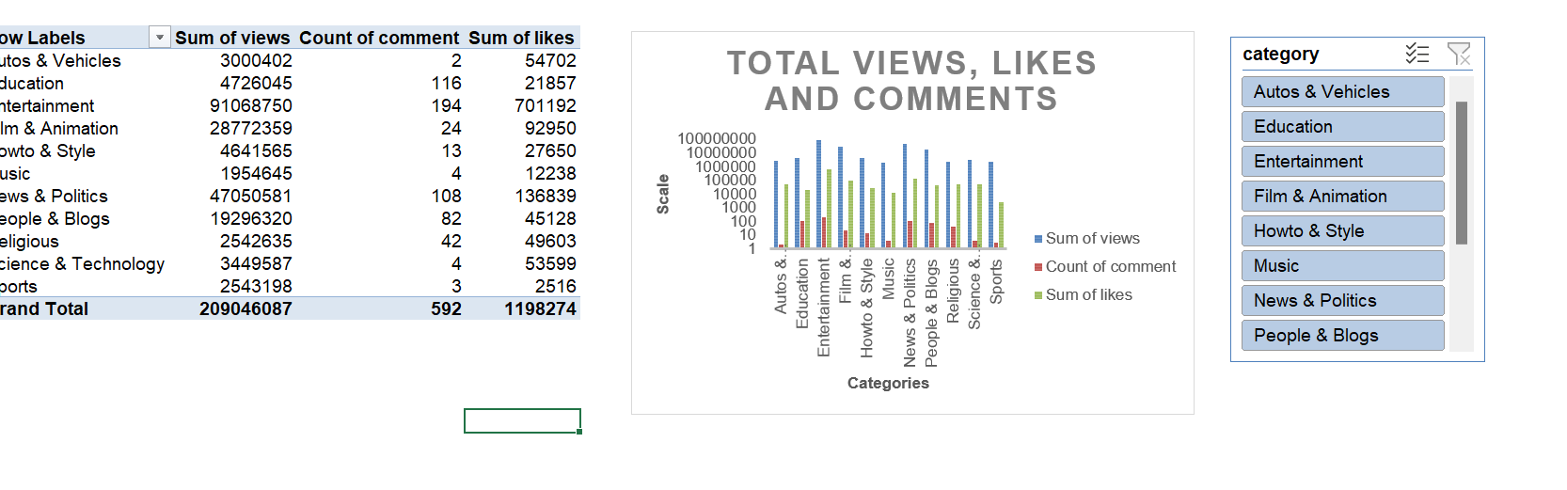
Question 7
The Category with the highest no of views, likes and comments is Entertainment.

Slide 9
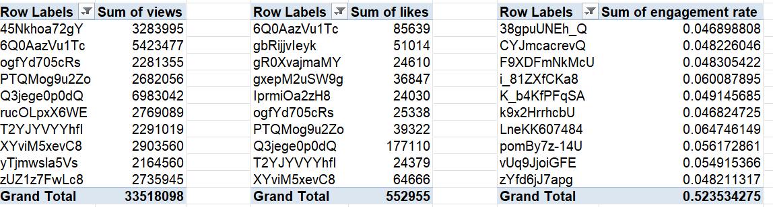
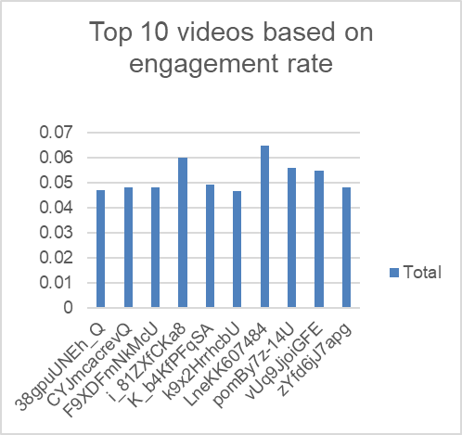
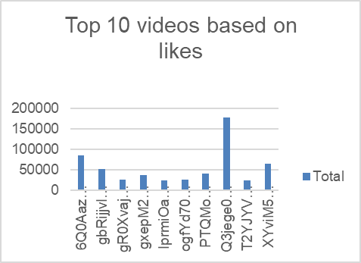
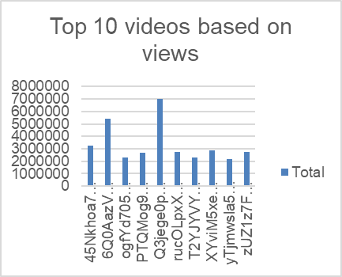
Question 8

Slide 10
Question 9

Slide 11
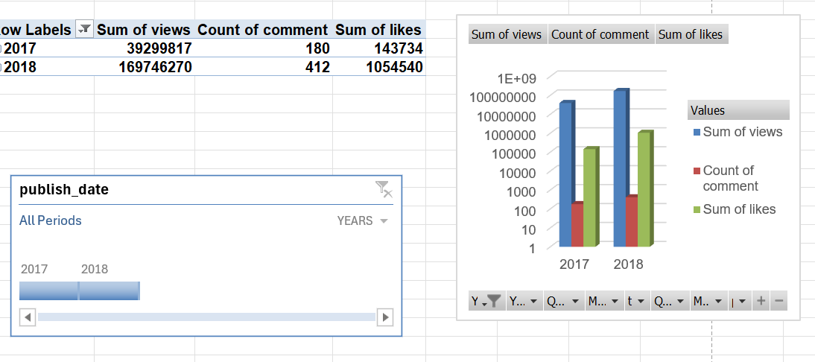
Question 10

Slide 12
Question 11

Slide 13
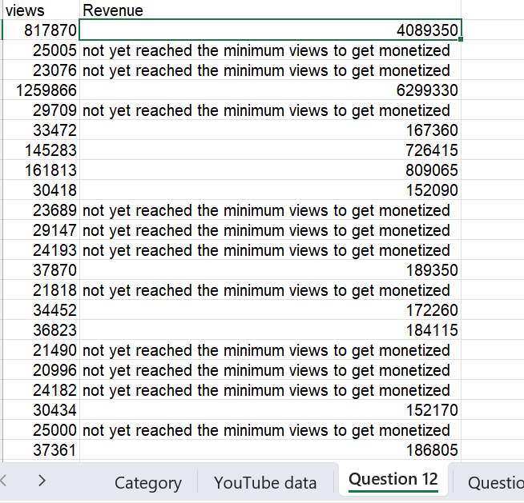
Question 12
I have given a condition where , if the total views of a video greater than or equal to 30000, then the revenue is 5 time the number of views for that video ,else it displays a message saying “not yet reached the minimum views to get monetized”.
IF(A2>=30000,A2*5,"not yet reached the minimum views to get monetized")

Slide 14
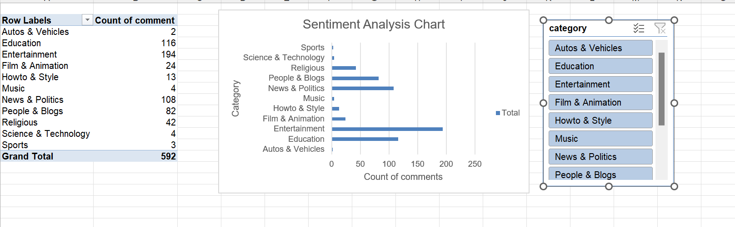
Question 13
From the above chart we can see that Entertainment Category has got maximum comments and Autos and Vehicles Category got minimum comments

Slide 15
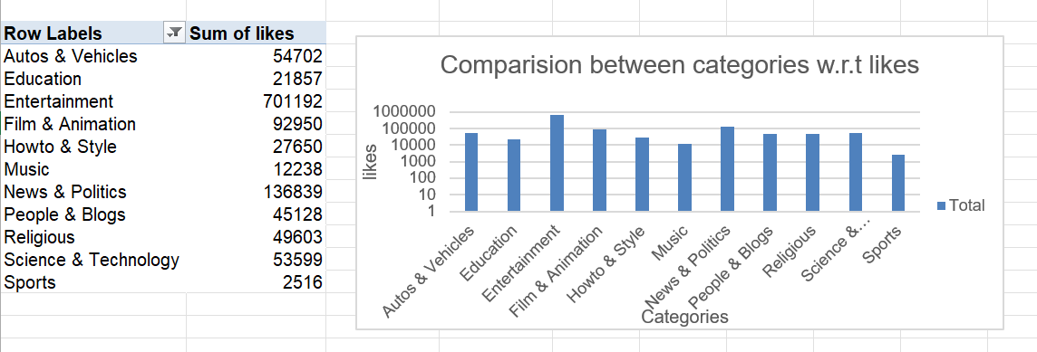
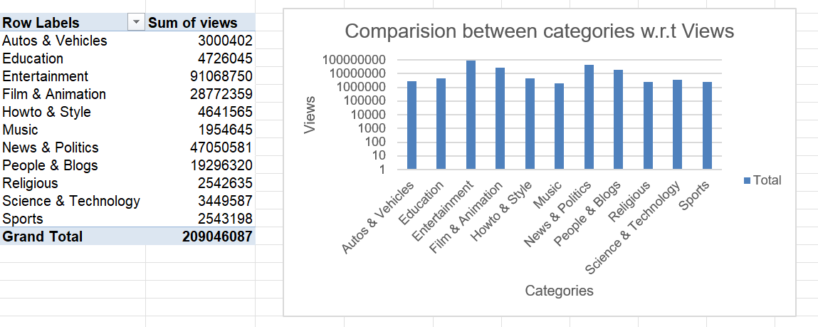
Question 14
Entertainment Category has the most no of likes
Entertainment category has the most no of views

Slide 16
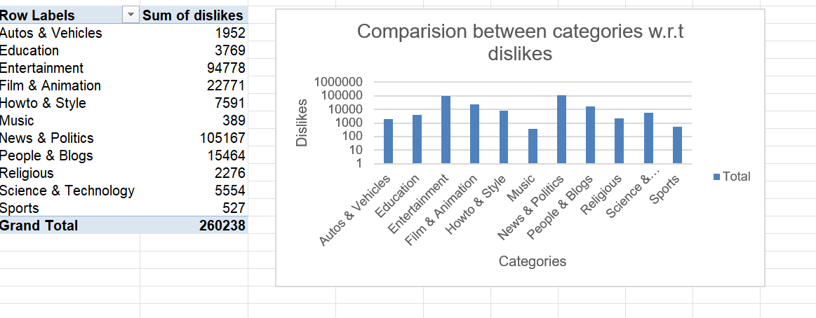
Question 14
News and Politics and Entertainment has the most no of dislikes

Slide 17
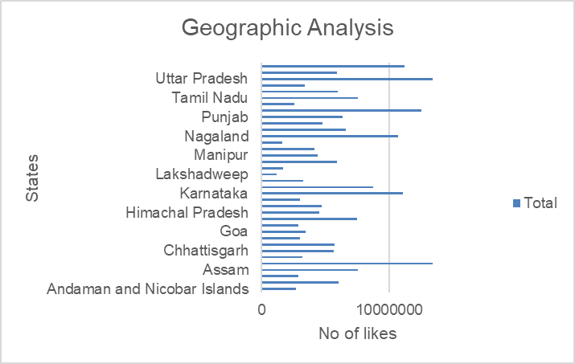
Question 16
Row Labels | Sum of views
Andaman and Nicobar Islands | 2711851
Andhra Pradesh | 6004535
Arunachal Pradesh | 2882953
Assam | 7528471
Bihar | 13411807
Chandigarh | 3206468
Chhattisgarh | 5658688
Dadra and Nagar Haveli and Daman and Diu | 5688166
Delhi | 3030601
Goa | 3438975
Gujarat | 2902732
Haryana | 7508335
Himachal Pradesh | 4506391
Jammu and Kashmir | 4681945
Jharkhand | 3001414
Karnataka | 11039543
Kerala | 8702065
Ladakh | 3262571
Lakshadweep | 1221848
Madhya Pradesh | 1677230
Maharashtra | 5926215
Manipur | 4367770
Meghalaya | 4140417
Mizoram | 1630595
Nagaland | 10672152
Odisha | 6602986
Puducherry | 4768383
Punjab | 6354892
Rajasthan | 12480132
Sikkim | 2607172
Tamil Nadu | 7532330
Telangana | 5969689
Tripura | 3406148
Uttar Pradesh | 13381048
Uttarakhand | 5926028
West Bengal | 11213541

Slide 18
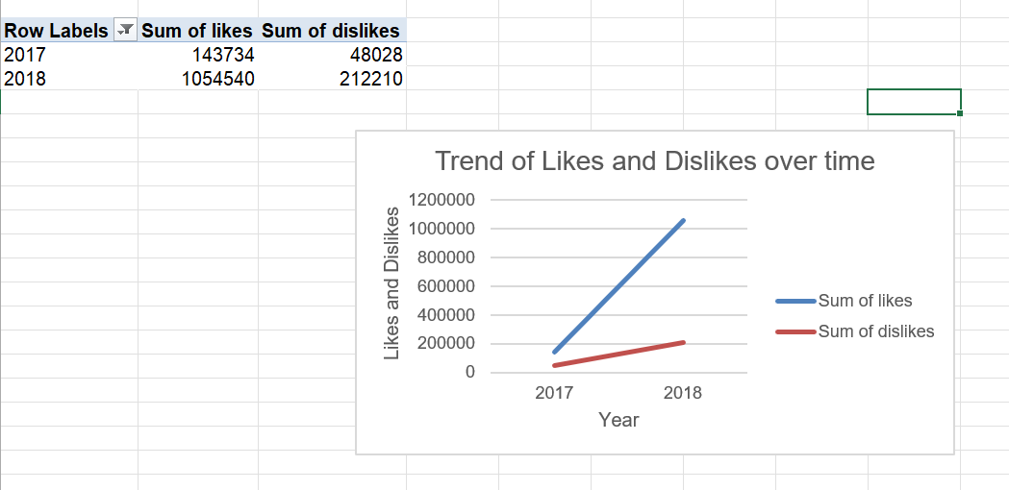
Question 18
As we can see, the sum of likes has increased sharply from 2017 to 2018, the sum of dislikes has also increased but very slowly from 2017 to 2018

Slide 19
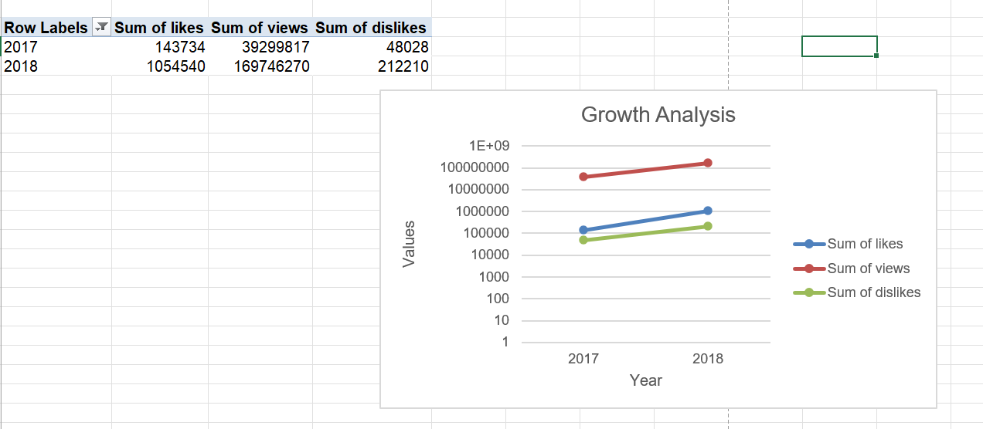
Question 19

